Slide 1
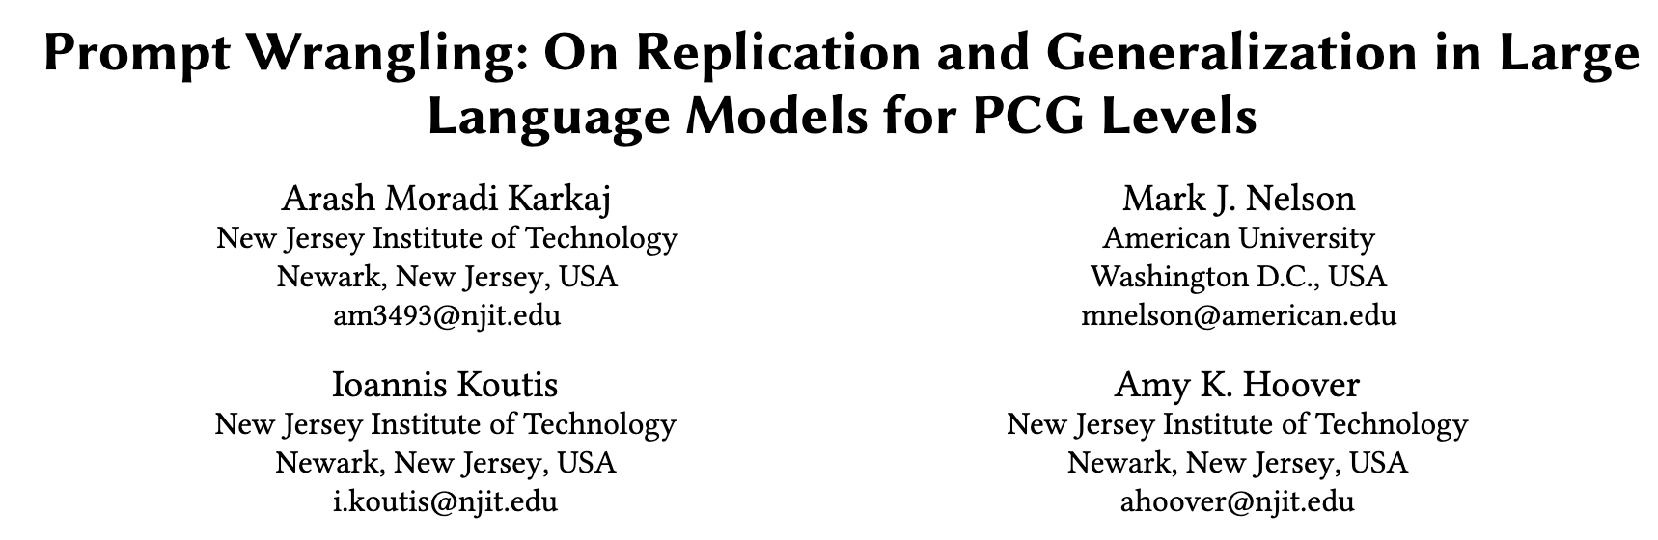


Slide 2
generality
The goal of reaching generality was there from the beginning of the field of AI
Notes:
The goal of reaching generality is a foundational goal of AI

Slide 3
The promise of “AI”
The promise of the field of AI, spelled out explicitly at its inception in the 1950s and repeated countless times since, is to develop machines that possess intelligence comparable to that of humans. [Chollet, 2019]
Notes:
It was stated right at the beginning of this field
The promise of the field of AI, spelled out explicitly at its inception in the 1950s and repeated countless times since, is to develop machines that possess intelligence comparable to that of humans. But AI has since been falling short of its ideal: although we are able to engineer systems that perform extremely well on specific tasks, they have still stark limitations, being brittle, data-hungry, unable to make sense of situations that deviate slightly from their training data or the assumptions of their creators, and unable to repurpose themselves to deal with novel tasks without significant involvement from human researchers.
Definition of AI: “Intelligence measures an agent’s ability to achieve goals in a wide range of environments.” Legg and Hutter 2007
This points out two characterizations:
1) emphasis on task-specific skill
2) focused on generality and adaptation

Slide 4
The promise of “AI”
The promise of the field of AI, spelled out explicitly at its inception in the 1950s and repeated countless times since, is to develop machines that possess intelligence comparable to that of humans. [Chollet, 2019]
Us humans have a great capability to generalize previously learned knowledge to new unseen before problems.

Slide 5
One of the forefathers of AI
McCarthy: “AI is the science and engineering of making machines do tasks they have never seen and have not been prepared for beforehand”.
Notes:
Echoed from time to time by the forefathers of AI
In contrast, a number of researchers have taken the position that intelligence lies in the general ability to acquire new skills through learning; an ability that could be directed to a wide range of previously unknown problems – perhaps even any problem at all.
McCarthy: “AI is the science and engineering of making machines do tasks they have never seen and have not been prepared for beforehand”.
This notion was also reflected on by Turing and Freiedberg, before this!

Slide 6
Argument
A machine learning model's ability to generalize is often considered a measure of its intelligence.
Notes:
Which brings us to the main/basis argument of this study

Slide 7
Argument
A machine learning model's ability to generalize is often considered a measure of its intelligence.
How Intelligent are Large Language Models?
Notes:
LLM are doing super intelligent stuff, but how intelligent are they in this sense?

Slide 8
LLM Sampling
We need a picture here that shows how the input is being transformed into the output, showing the attention module and how the training process on the training data determines the weights for each word,
Notes:
Lets start by taking a look at how the LLMs sample their output from an input prompt

Slide 9
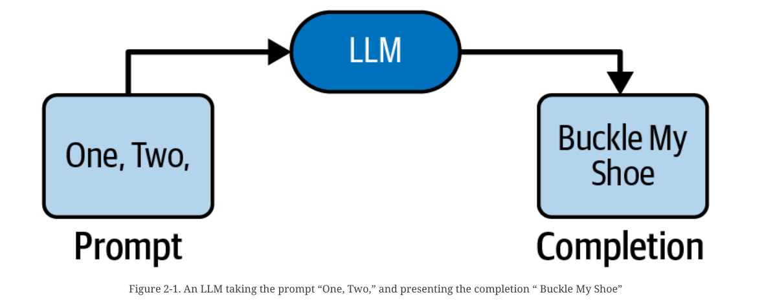
LLM Sampling
Large
Language
Model
prompt
Notes:
Lets start by taking a look at how the LLMs sample their output from an input prompt

Slide 10
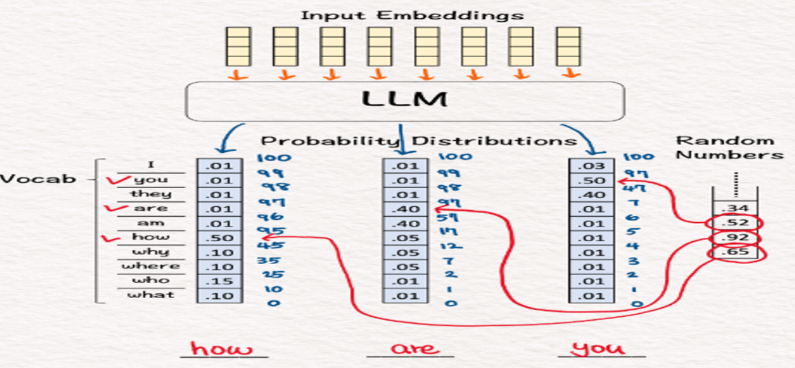
LLM Sampling
Notes:
Lets start by taking a look at how the LLMs sample their output from an input prompt

Slide 11
Orange-Box LLM
training data for most large language models (LLMs) is rarely publicly accessible
Notes:
However given that the training data for most large language models (LLMs) is rarely publicly accessible, the extent to which LLMs memorize or generalize is an open research question.

Slide 12
LLM: memorize vs. generalize
training data for most large language models (LLMs) is rarely publicly accessible
the extent to which LLMs memorize/regurgitate or generalize is an open research question.
Notes:
However given that the training data for most large language models (LLMs) is rarely publicly accessible, the extent to which LLMs memorize or generalize is an open research question.

Slide 13
LLM Generalization
Generalization
The objective is to see how (if at all) the LLM generalizes previously learned knowledge to generate solutions to unseen problems

Slide 14
Zero-Shot LLM Generalization
By logic, we start off by not giving an example at all.
Prompt-based LLM activation that contains zero examples
Zero-Shot Prompting [1]
Jason Wei et al. "Finetuned language models are zero-shot learners." arXiv preprint arXiv:2109.01652 (2021).

Slide 15
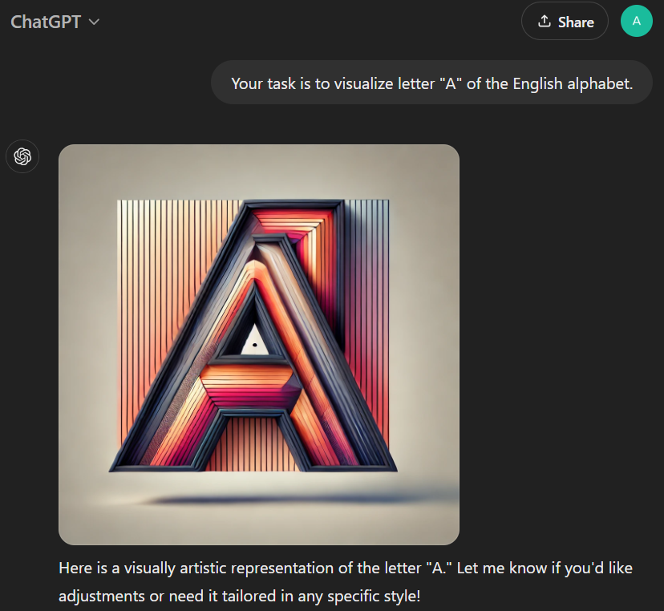
Zero-Shot Example: Visualize!
Zero-shot prompt
LLM’s response

Slide 16
One-Shot LLM Generalization
How about proving just one example
One-Shot Prompting [1]
Tom Brown et al. "Language models are few-shot learners." Advances in neural information processing systems 33 (2020): 1877-1901.

Slide 17
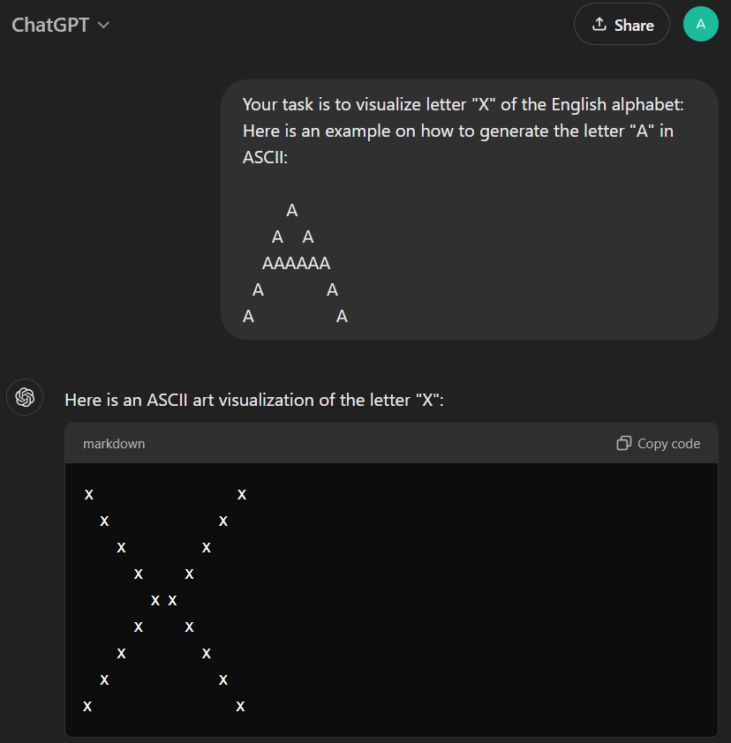
One-Shot LLM Generalization
One-shot prompt
LLM’s response

Slide 18
LLM Replicable?
We also need to determine if the results of LLMs can be replicable
Replicating and reproducing research results is a cornerstone of the scientific process [1]
National Academies of Sciences, Engineering, and Medicine. 2019. Reproducibility and Replicability in Science. The National Academies Press.

Slide 19
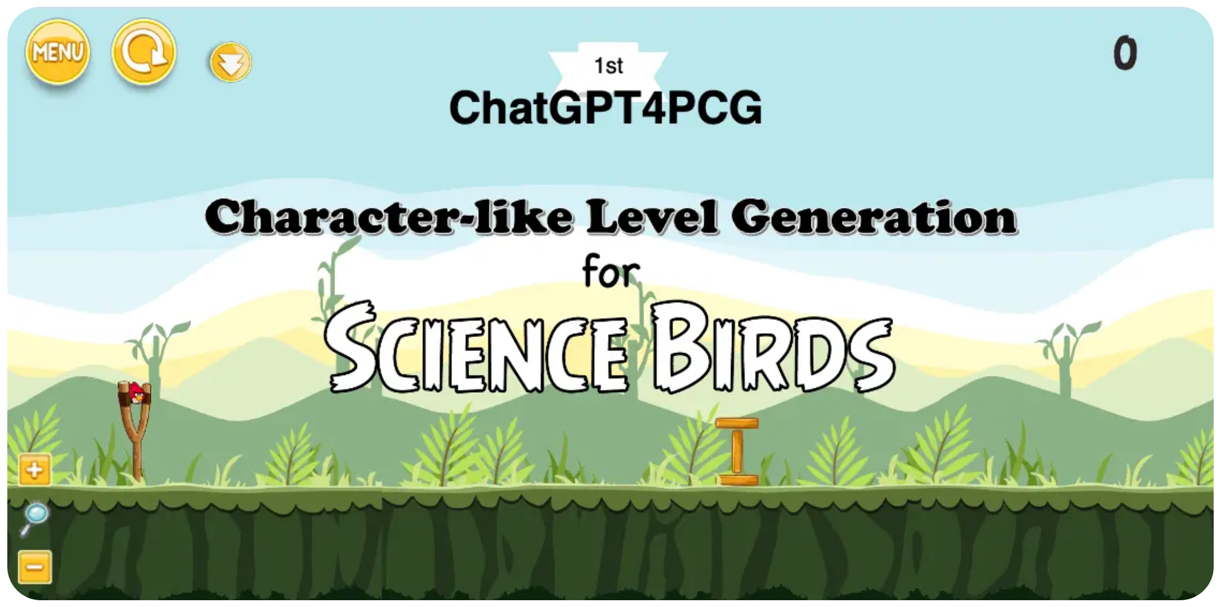
Domain: ChatGPT4PCG
The 1st ChatGPT4PCG competition held at IEEE Conference on Games 2023
Notes:
proposes a new task for evaluating LLM performance where the winner of the competition is the team who submits the highest-scoring LLM-prompt.
The prompts may contain both natural language text in English in addition to a game-specific programming language that can be loaded into a Unity-based game called Science Birds.

Slide 20
Domain: ChatGPT4PCG
15 entries
Notes:
proposes a new task for evaluating LLM performance where the winner of the competition is the team who submits the highest-scoring LLM-prompt.
The prompts may contain both natural language text in English in addition to a game-specific programming language that can be loaded into a Unity-based game called Science Birds.

Slide 21
Replication Experiment
Re-ran Competition: Is it possible for us to re-run the competition locally, later and get the same results?
Intuition: Randomization inherent in Sampling with Temperature
Sample Size of 𝑛 = 10 or 𝑛 = 100
ChatGPT responses per letter per prompt (i.e., 260 responses in total)
ChatGPT responses per letter per prompt (i.e., 2600 responses in total)

Slide 22
Generalization Experiment
Zero-Shot Generalization

Slide 23
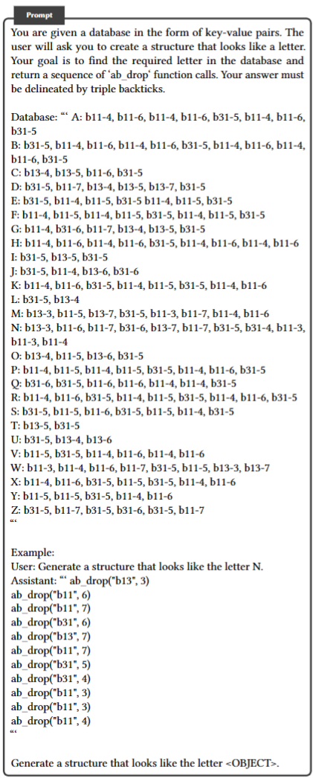
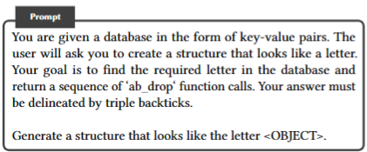
Generalization Experiment
Zero-Shot Generalization

Slide 24
Generalization Experiment
One-Shot Generalization

Slide 25
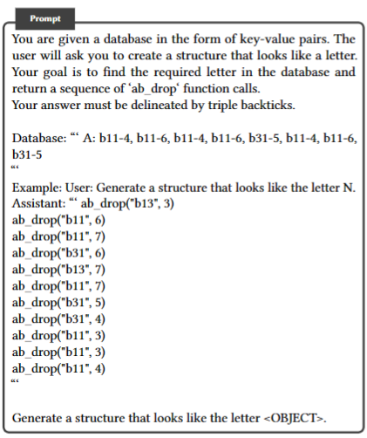
Generalization Experiment
One-Shot Generalization

Slide 26
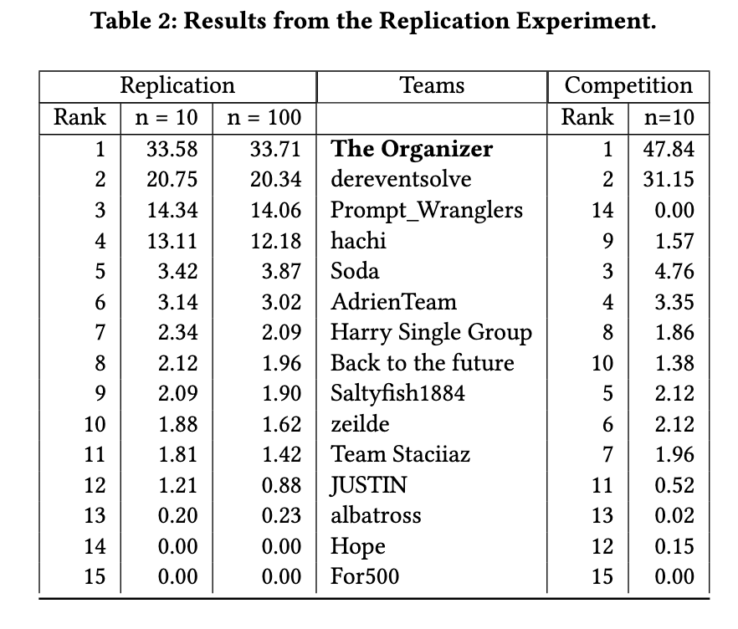
Results: Replication
The results are mostly replicable
N=10 is sufficient
Some prompts did exceptionally well, but why?

Slide 27
Results: Replication
the results suggest that the differences in ranking are caused by a difference in the responses generated by ChatGPT.

Slide 28
Results: Replication
the results suggest that the differences in ranking are caused by a difference in the responses generated by ChatGPT.
LLMs can be sensitive to the exact wording in a prompt, and responses to a prompt are likely to vary between LLMs and even between different versions of the same LLM.

Slide 29
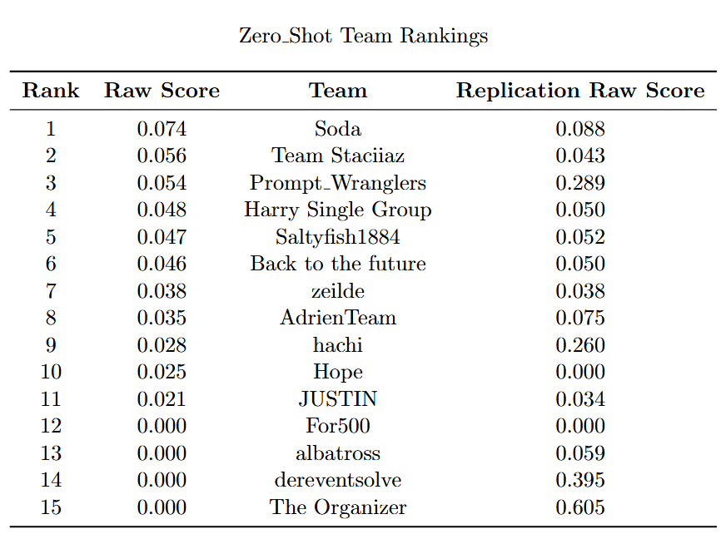
Results: Generalization
Zero-Shot
most prompts’ performance is reduced significantly

Slide 30
Results: Generalization
Zero-Shot
Interestingly, those prompts that basically were look-up tables ranked last
Why?

Slide 31
Results: Generalization
Zero-Shot

Slide 32
Results: Generalization
One-Shot

Slide 33
Results: Generalization
One-Shot
In the one-shot setting, the best performing prompts improve up only slightly from the zero-shot results

Slide 34
Results: Generalization
One-Shot
In the one-shot setting, the best performing prompts improve up only slightly from the zero-shot results
the performance of some individual prompts does improve significantly from the zero-shot

Slide 35
Results: Generalization
One-Shot
In the one-shot setting, the best performing prompts improve up only slightly from the zero-shot results
the performance of some individual prompts does improve significantly from the zero-shot
Overall performance varies quite a bit, and in some cases is highly dependent on which single example is given as the 1-shot example.

Slide 36
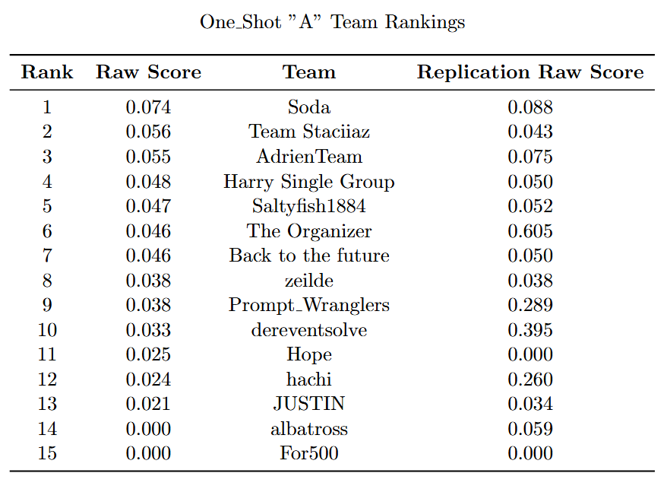
Results: Generalization
One-Shot

Slide 37
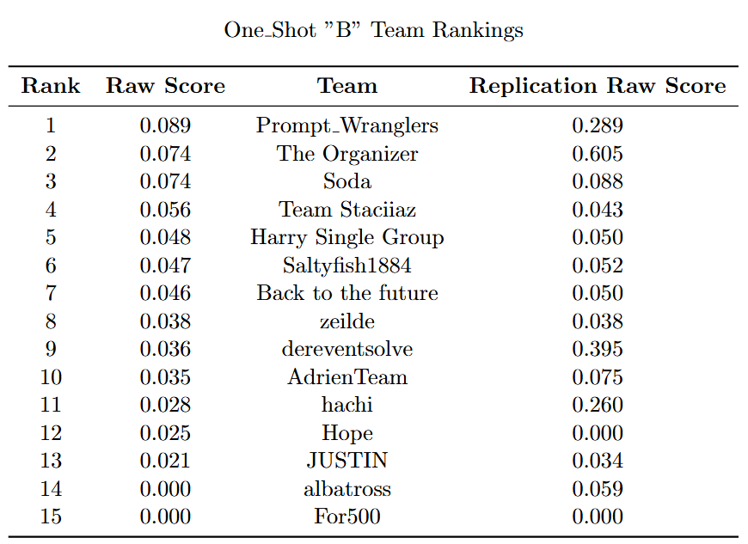
Results: Generalization
One-Shot

Slide 38
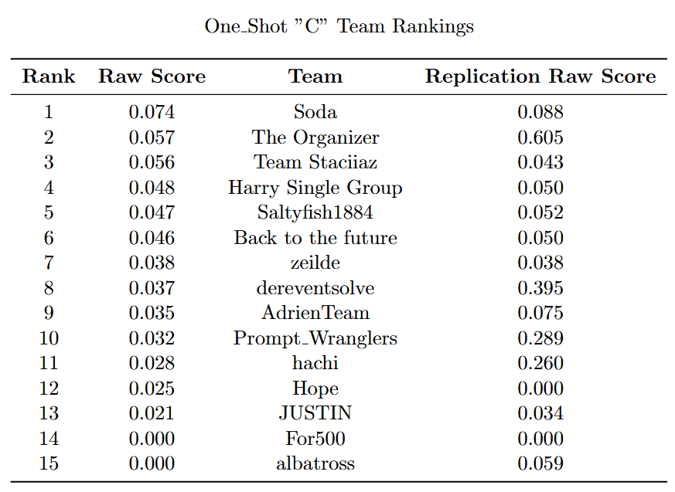
Results: Generalization
One-Shot

Slide 39
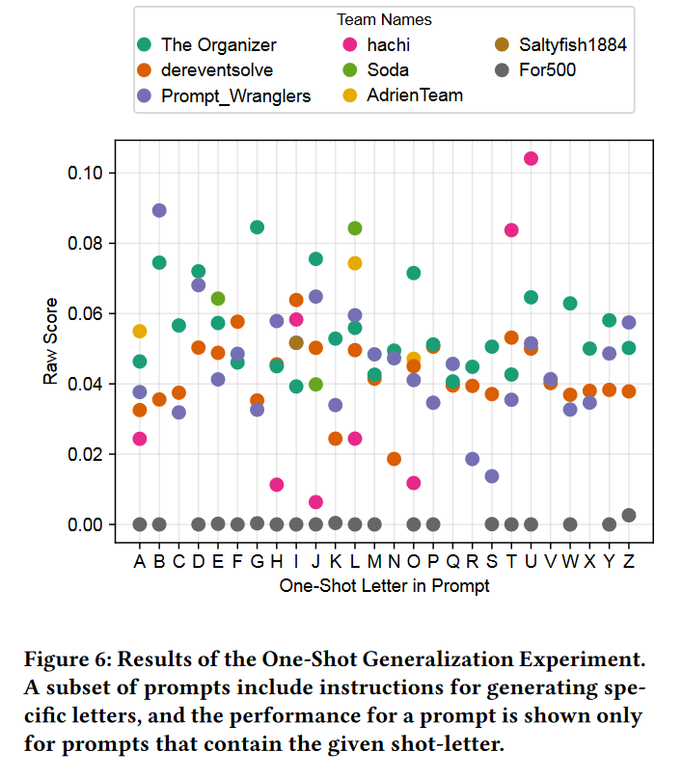
Results: Generalization
One-Shot
There scores improve compared to Zero-Shot,
But inconclusive which letter/shot is more generalizable
Notes:
But inconclusive which letter/shot is more generalizable
Meaning which letter contains more information that if learned the LLM can generate more letters by generalizing

Slide 40
Results: Generalization
N-Shot
Number of shot 0 -> 26 (no explicit solution example)
0
A
AB
ABC
ABC…Z
Notes:
But inconclusive which letter/shot is more generalizable
Meaning which letter contains more information that if learned the LLM can generate more letters by generalizing

Slide 41
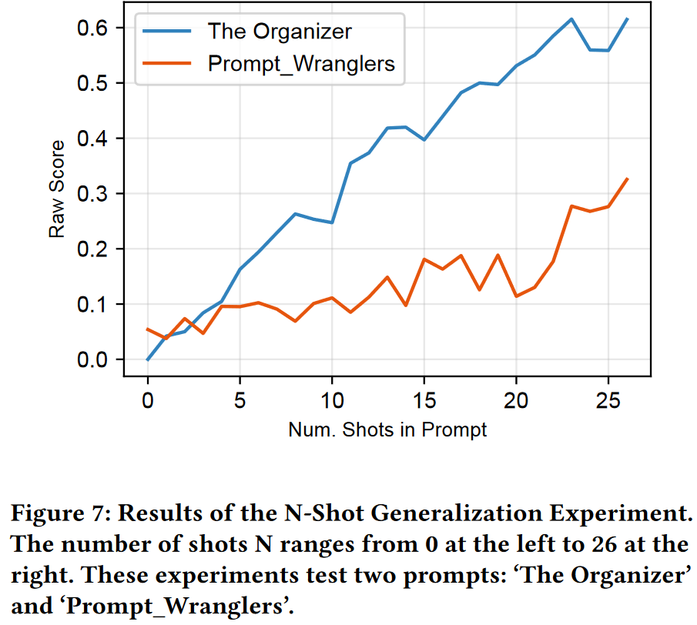
Results: Generalization
N-Shot
The linearly increasing pattern in both prompts suggest there isn’t much generalization going on!
Notes:
But inconclusive which letter/shot is more generalizable
Meaning which letter contains more information that if learned the LLM can generate more letters by generalizing

Slide 42
Discussion
OpenAI ChatGPT Models change a lot, hard to replicate

Slide 45
ChatGPT4PCG

Slide 46
Experiment 1: Replication Experiment
The replication experiment investigates whether the original prompts achieve approximately the same scores six months after the competition.
ChatGPT-3.5 is closed source and it is unclear when changes are made that may impact the generated levels.
This experiment also examines whether scores are impacted by increasing the number of levels generated per letter to 100.
The results of the replication experiment show that ChatGPT-3.5 is changing over the time span of six months, and that these small changes can significantly impact how prompts score, whether ten or 100 levels are evaluated.
While the sample size is likely adequate for the competition, to make conclusions about prompts submitted to the competition over the course of years, it will be important to query LLMs with static weights.

Slide 47
Experiment 2: Generalization Experiment
The generalization experiment examines the ability of prompts to generate levels it has not yet seen (i.e., that are not hard-coded in the prompt).
Prompts are modified to contain zero-shots or example letters in the zero-shot setting or one-shot in the one-shot setting.
The prompts in the one-shot setting are tested per letter given that prompts contain different example letters and some letters are more difficult to generate than others.
N-shot prompting is specified for a small subset of prompts and example letters.
The goal of this experiment is to understand whether successful prompts are generalizing or if it is the quality of their lookup tables that determines their score.
Results show that these modified prompts perform significantly worse than their unmodified counterparts and prompts that generalize well are not necessarily those that perform well in the competition.
These results suggest that generalizing with these new level generators is an open problem to explore.

Slide 48
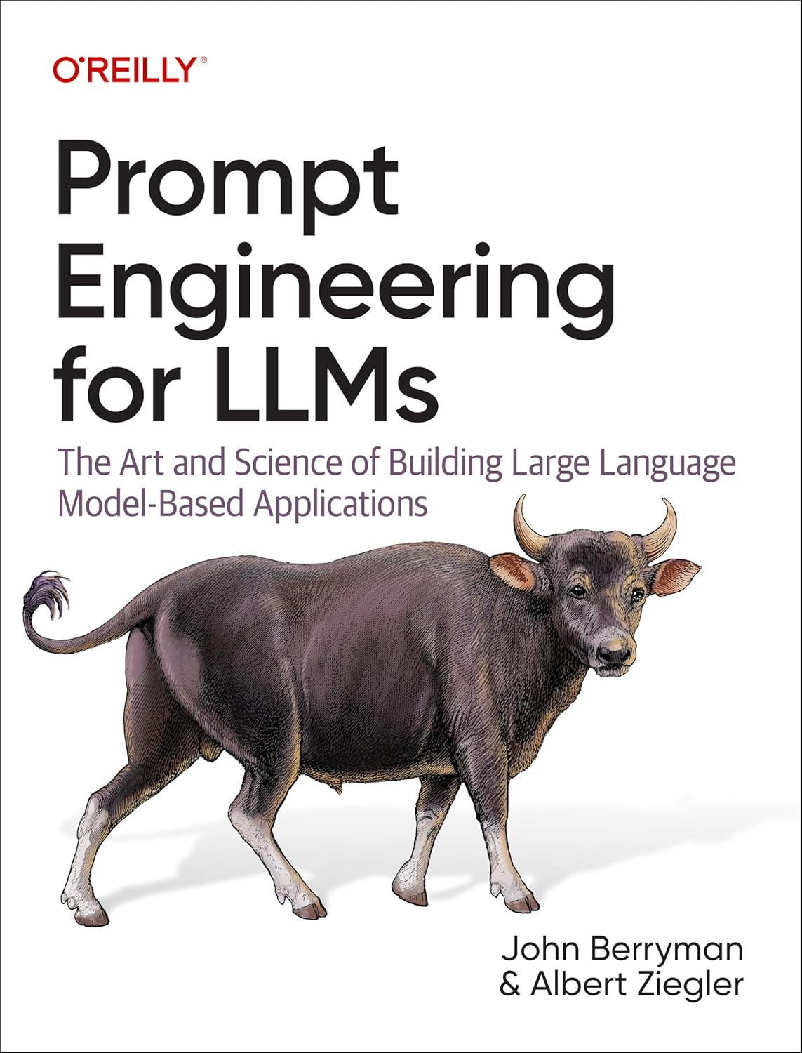
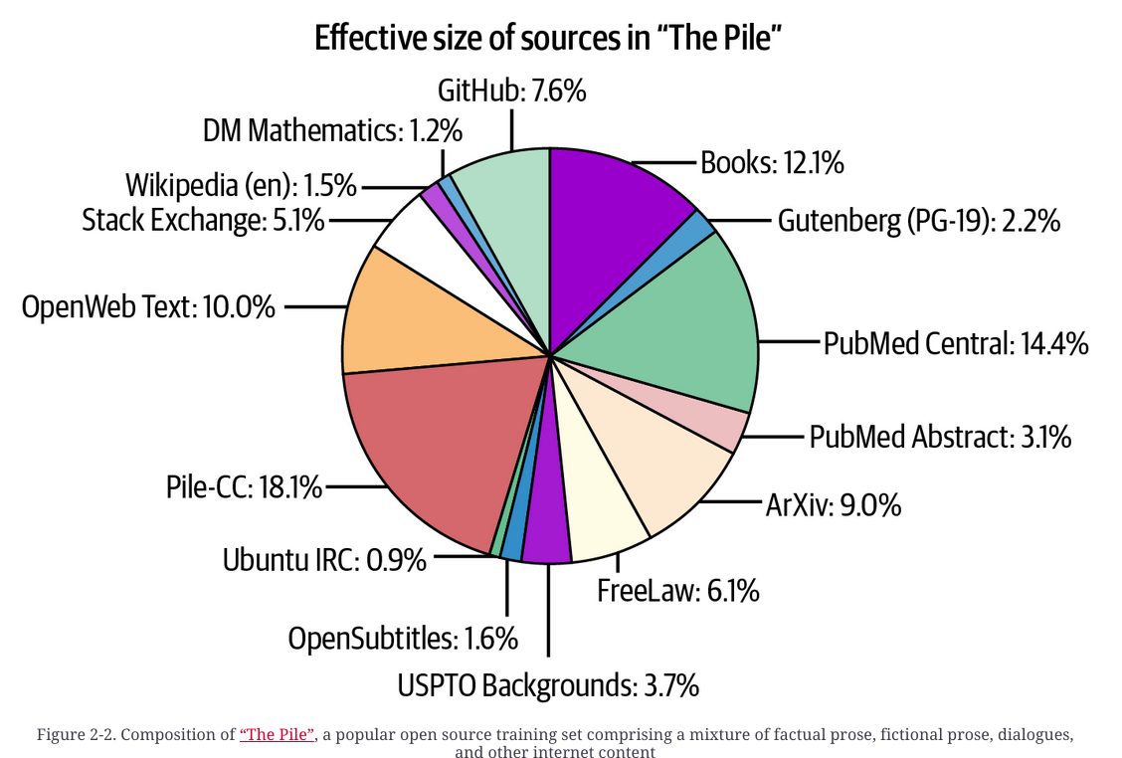

Slide 49
Introduction

